Slide 1

Video Game Database
Byte Thugs -N- Harmony

Slide 2

Introduction
Primary Deliverable: Backend database for video game website
Functions: rating, reviewing, searching overall game information
Future Front End Functions:
Account creation with profile customization
Create reviews and ratings
Access other reviews and ratings, game and platform pricing, release dates, and game genres
Notes:
Database includes:
Game information
Company information
Users information
Reviews information
Genre
Platform information

Slide 3
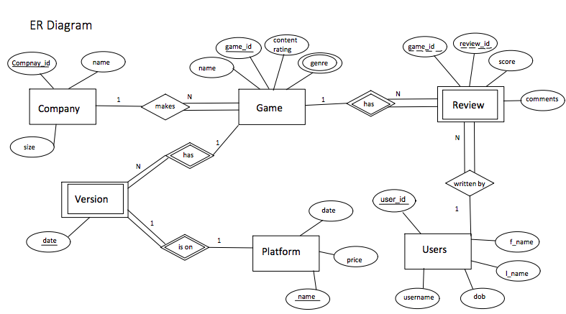
ER Diagram

Slide 4
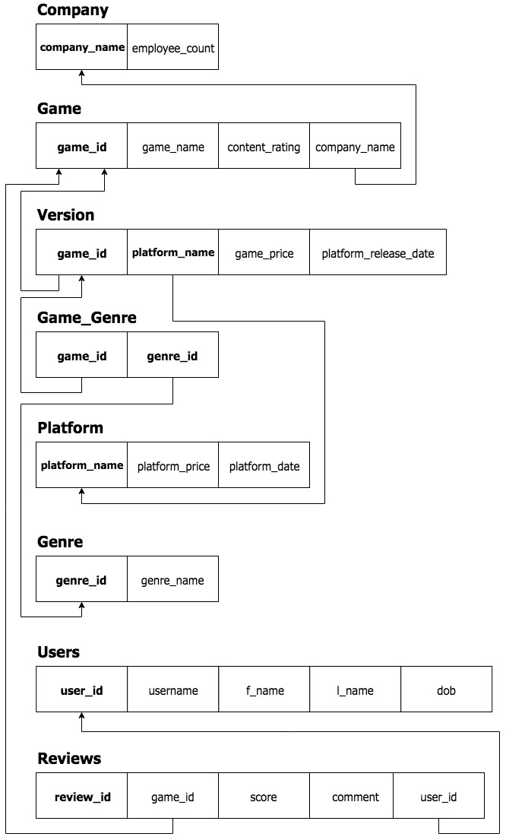
Relational Model

Slide 5
Normalization
In early stages, the tables were not all in BCNF:
Table | Functional Dependencies
Company | company_name -> employee_count
Game | game_id -> game_name, content_rating, company_name, genre_id genre_id -> genre_name
Version | game_id, platform_name -> platform_release_date, game_price platform_name -> platform_price, platform_date
User | user_id -> username, f_name, l_name, Dob
Review | review_id -> game_id, score, comment, user_id

Slide 6
Normalization
We then normalized our tables to be BCNF:
Table | Functional Dependencies
Company | company_name -> employee_count
Game | game_id -> game_name, content_rating, company_name
Genre | genre_id -> genre_name
Game_Genre | genre_id, game_id
Platform | platform_name -> platform_price, platform_date
Version | game_id, platform_name -> platform_release_date, game_price
User | user_id -> username, f_name, l_name, Dob
Review | review_id -> game_id, score, comment, user_id

Slide 7
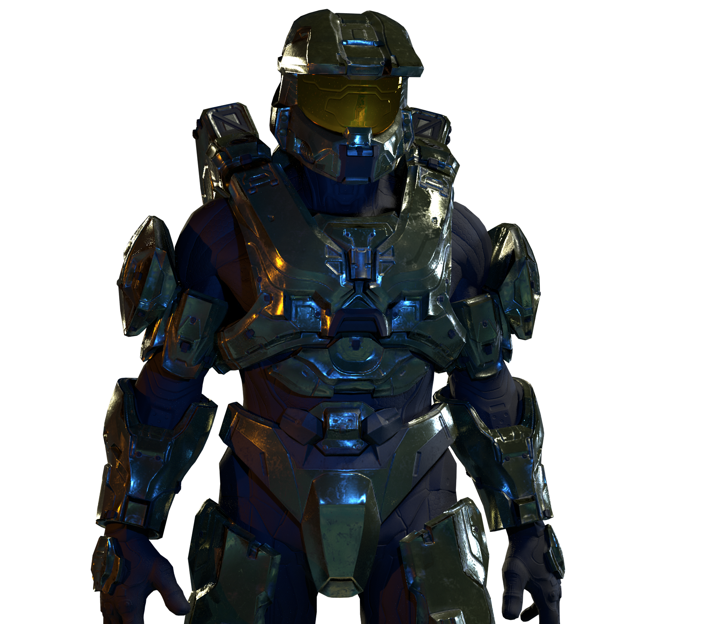
SQL Queries
Possible query statements include:
Listing a genre of game with a specific rating from a given time range
Listing top games by score
List all games related to a given game - relation is done by genre
List all games created by a specific company
Show all reviews created by a specific user
Notes:
Retrieving top 5 users with most reviews
Listing reviews with ratings within a given range
Listing a genre of game with a specific rating from a given time range
Listing top games by score
List all games related to a given game - relation is done by genre
List all games created by a specific company
Show all reviews created by a specific user

Slide 8
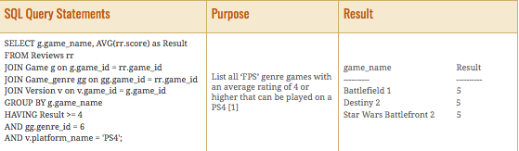
SQL Queries Continued
Possible query statements include:
Retrieving top 5 users with most reviews
Listing reviews with ratings within a given range (example below)
Notes:
Retrieving top 5 users with most reviews
Listing reviews with ratings within a given range
Listing a genre of game with a specific rating from a given time range
Listing top games by score
List all games related to a given game - relation is done by genre
List all games created by a specific company
Show all reviews created by a specific user

Slide 9
Integrity of Application
Consistency of data
Access and update control
Review per game control

Slide 10

Conclusion Criteria
Evaluated the project on four criteria:
Effort
Successes
Areas of Improvement
Learning Outcomes

Slide 11
Conclusion: Effort
The effort on the project is broken down into categories:
Proposal: met multiple times, formulated idea
Report: multiple meetings, collaboration, extra SQL queries
Presentation: covers all aspects of project, organized
Conclusion: significant effort for this project

Slide 12

Conclusion: Successes
All team members spent effort on:
Proposal
Report
Presentation
Kept quality and professionalism in mind throughout project

Slide 13
Conclusion: Areas of Improvement
Assign a team lead
Delegate roles and project tasks at project start date
Practice consistent and clear communication to eliminate confusion
When opening/closing a task, update team members to avoid overlap, redundancy, and uneven distribution
Utilize a team schedule and hold team members accountable for attending all mandatory meetings

Slide 14


Conclusion: Learning Outcomes
Learned and practice how to execute:
Project proposal
Database design
Implementation
Teamwork
Collaboration
Project delivery
From a small vision, we were able to create a tangible deliverable!

